Slide 1
GUVI CAPSTONE PROJECT CRAFTING COMPELLING WEB PRESENCES (MBM6)
BY GANDHIRAJAN KM

Slide 2

APPLE

Slide 3
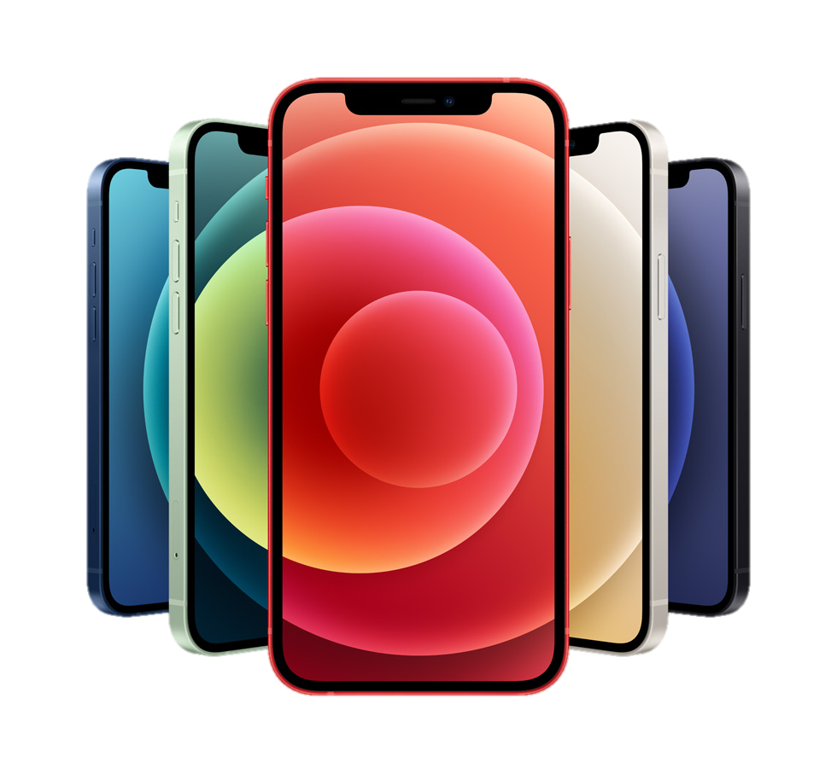
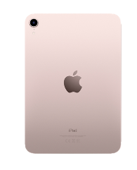
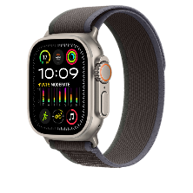
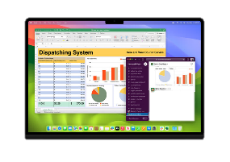
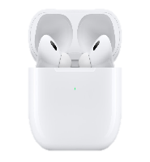
PRODUCTS
IPHONE
APPLE WATCH
IPAD
MAC BOOK
AIRPODS

Slide 4
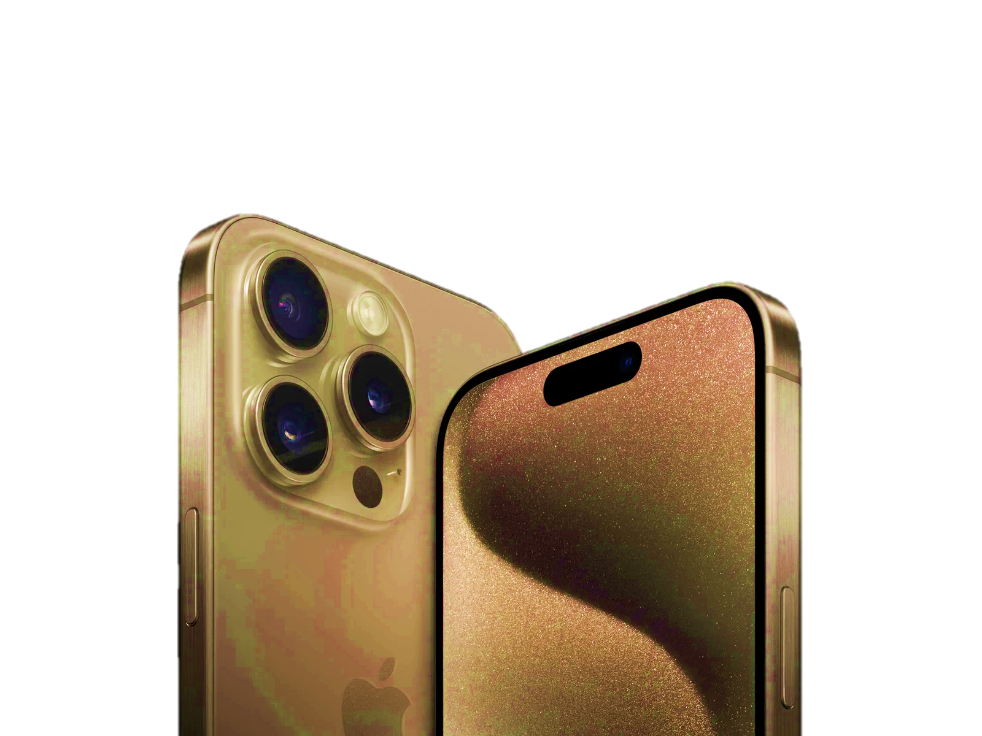
IPHONE
Sleek and durable design, featuring premium glass and metal construction.
Vibrant OLED or Super Retina XDR displays with varied screen sizes available.
Powered by custom-designed A-series chips for optimized performance and efficiency.
Advanced camera system with features like Portrait mode, Night mode, and excellent photo and video quality.
Runs on iOS, known for its intuitive interface, regular updates, and robust security features.

Slide 5
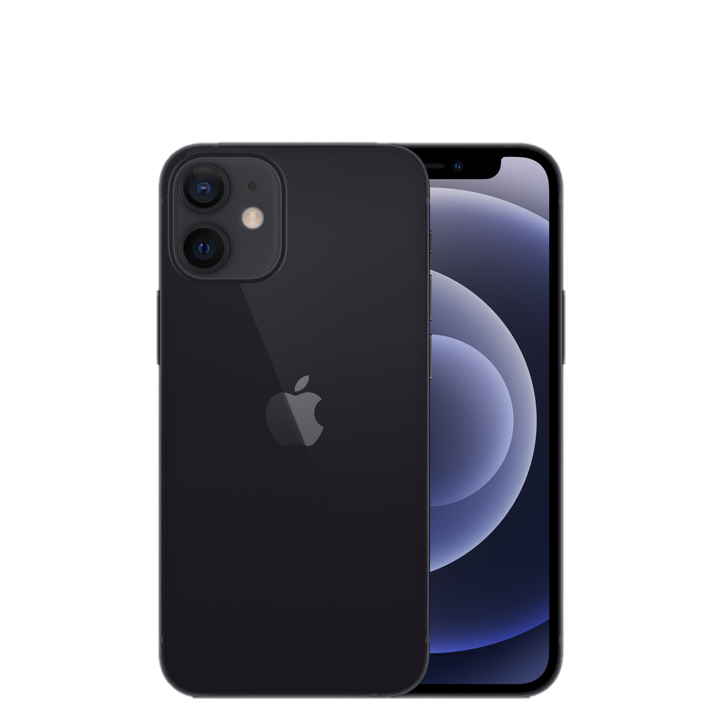
IPHONE
Access to a vast array of apps through the App Store, enhancing productivity and entertainment.
Seamless integration with other Apple devices for enhanced continuity and productivity.
Supports latest connectivity standards such as Wi-Fi 6 and 5G (in newer models).
Improved battery longevity and fast-charging capabilities, with support for wireless charging.
Strong emphasis on user privacy and security, with features like Face ID and Touch ID for device authentication, and end-to-end encryption for data protection.

Slide 6
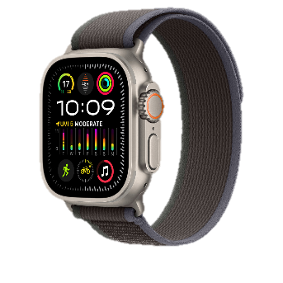
APPLE WATCH
Sleek, customizable design with stylish watch faces and bands.
Monitors heart rate, activity, and offers advanced health metrics.
Motivates users to stay active throughout the day with visual activity tracking.
Regular software updates for new features and enhancements.
Monitors heart rate, ECG, blood oxygen levels, sleep, and detects falls.

Slide 7
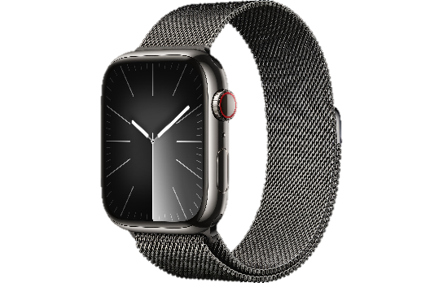
APPLE WATCH
Receives notifications, calls, messages, and access apps directly.
Wide range of apps for productivity, health, and entertainment.
Voice commands for reminders, messages, and smart home control.
Personalize watch faces for quick access to apps and information.
Designed for water-based activities like swimming.

Slide 8
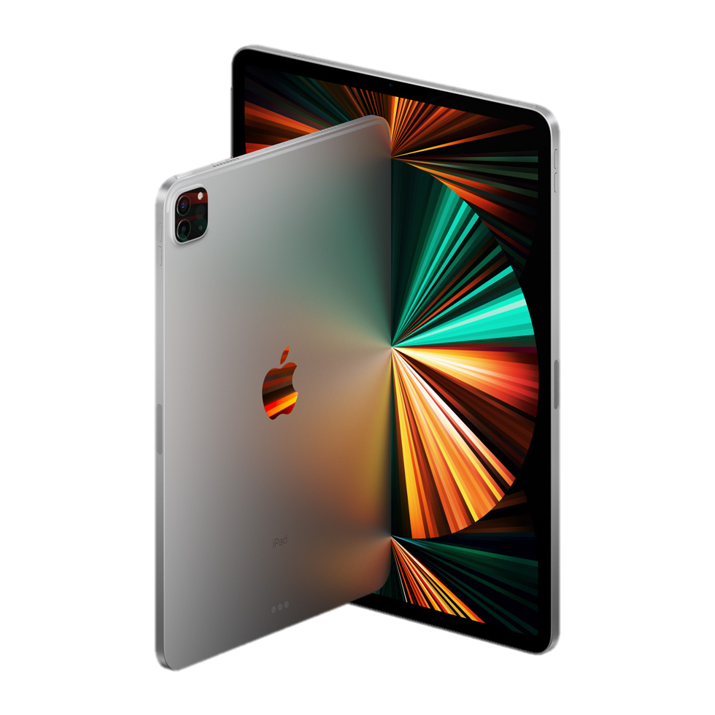
IPAD
Equipped with Apple's custom-designed chips for seamless multitasking, gaming, and productivity.
High-resolution Retina display with True Tone technology for immersive viewing experiences.
Allows for precise writing, drawing, and note-taking, enhancing creativity and productivity.
Sleek and portable with a range of sizes and configurations to suit various needs.
Easily attaches for a laptop-like typing experience, ideal for work or school tasks.

Slide 9
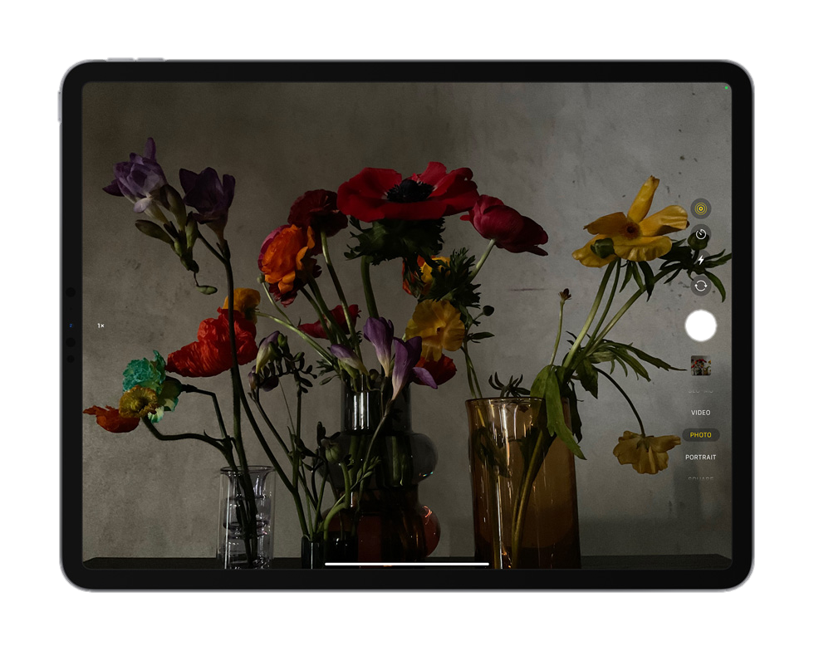
IPAD
Runs on iPad OS, offering access to a vast library of apps tailored for productivity, creativity, and entertainment.
Supports Split View, Slide Over, and Drag and Drop features for efficient multitasking.
Utilizes AR capabilities for immersive learning, gaming, and creative experiences.
Provides all-day battery life, allowing for extended use without frequent charging.
Built-in security features like Touch ID or Face ID ensure device and data protection.

Slide 10
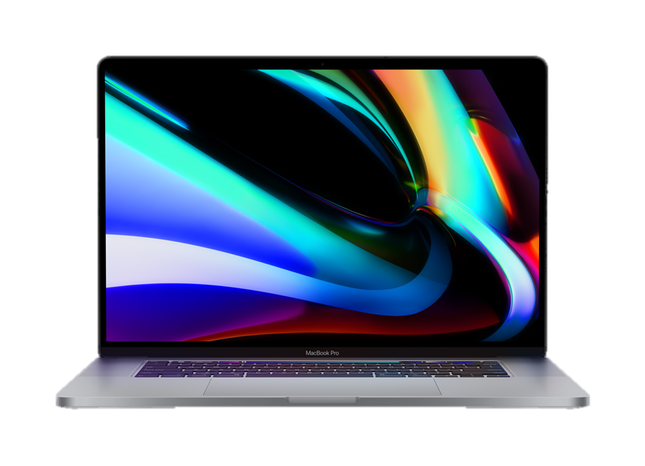
MAC BOOK
High-resolution display with vibrant colors and sharp image quality.
Equipped with Apple's custom-designed M1 chip for fast and efficient performance.
All-day battery life for uninterrupted productivity on the go.
Sleek and elegant aluminum construction with a minimalist aesthetic.
Portable design makes it easy to carry and use anywhere.

Slide 11

MAC BOOK
Seamlessly integrates with other Apple devices and services for enhanced productivity.
High-speed Thunderbolt ports for fast data transfer and connectivity.
Built-in HD camera for high-quality video calls and conferences.
Features like Touch ID and T2 Security Chip ensure data protection and device security.
Made with recycled materials and energy-efficient design for reduced environmental impact.

Slide 12
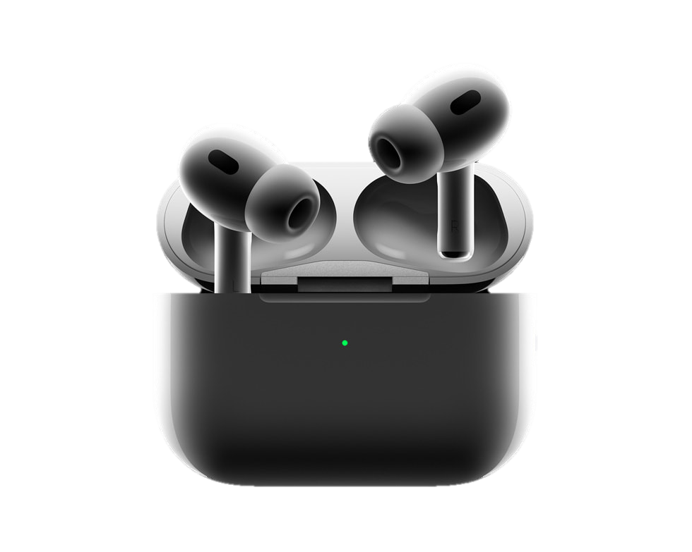
AIR PODS
Instant pairing with Apple devices via Bluetooth for easy setup.
Deliver clear sound and balanced bass for immersive listening experiences.
Completely wireless design for freedom of movement.
Touch-sensitive controls for music playback, calls, and Siri activation.
Up to 5 hours of listening time on a single charge, with additional charges provided by the charging case.

Slide 13
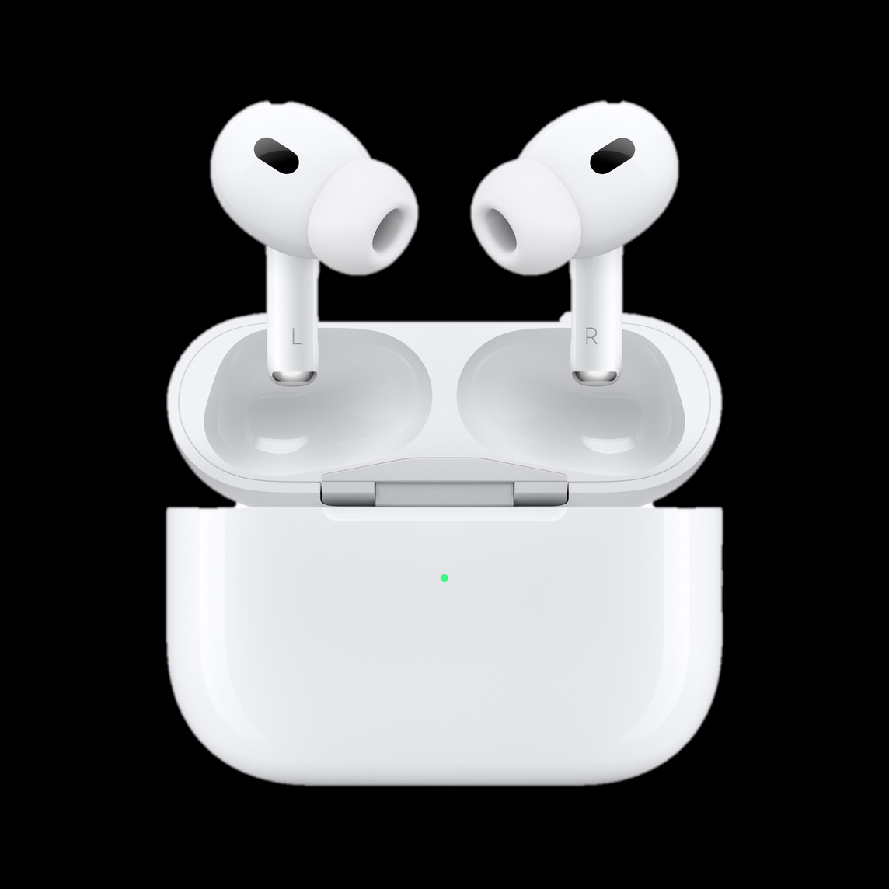
AIR PODS
Fast charging capability provides several hours of listening time with just a few minutes of charging.
Hands-free access to Siri for voice commands and assistance.
Ergonomically designed for a secure and comfortable fit in the ear.
Pocket-sized charging case for easy storage and transport.
Compatible with a wide range of Apple and non-Apple devices for versatile use.

Slide 14
Determine the platform on which the website is developed ( use online tools to identify)

Slide 15

TOOL

Slide 16
TOOL
ADOBE ANALYTICS
(ANALYTICS)
APPLE MAPKIT JS
(MAP)
HSTS
(SECURITY)
ADOBE ANALYTICS
(ANALYTICS)
APPLE MAPKIT JS
(MAP)
HSTS
(SECURITY)
APPLE MAIL
(MAIL)
NEXT.JS
(WEBSERVER & WEB FRAMEWORKS)
ADOBE TARGET
(PERSONALIZATION & A/B TESTING)

Slide 17
TOOL
NEXT.JS
(STATIC SITE GENERATOR & JAVA SCRIPT FRAMEWORKS)
NODE.JS
(PROGRAMMNG LANGUAGE)
REACT
(JAVASCRIPT FRAMEWORK)
PREACT
(JAVASCRIPT LIBRARIES)
LOADASH
(JAVASCRIPT LIBRARIES)
OPEN GRAPH
(MISCELLANEOUS)

Slide 18
TEST THE WEBSITE’S RESPONSIVE DESIGN AND MOBILE OPTIMIZATION(SHARE THE REPORT) TEST A MINIMUM OF 5 PAGES (USE ONLINE TOOLS TO FIND)

Slide 19


TOOL
VIEWPORT RESIZER
CHROME DEVELOPER TOOLS

Slide 20
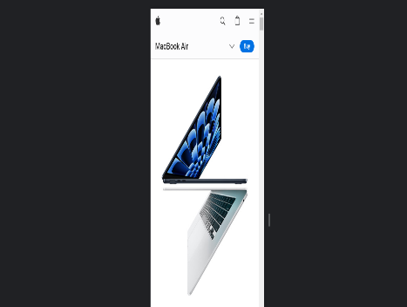
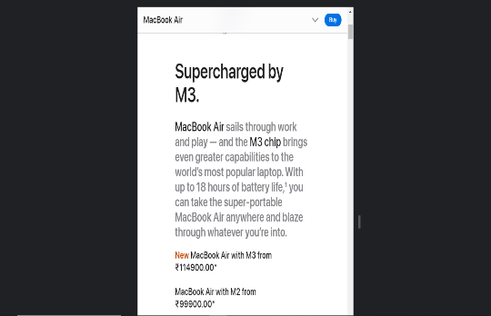
HOME PAGE
IPHONE – 375x812(POTRAIT) RESPONSIVE
SMALL TABLET -600x800 (POTRAIT) RESPONSIVE

Slide 21
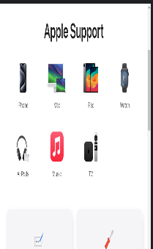
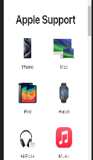
SUPPORT PAGE
IPAD – 768x1024(POTRAIT) RESPONSIVE
IPHONE – 375x812(POTRAIT) RESPONSIVE

Slide 22
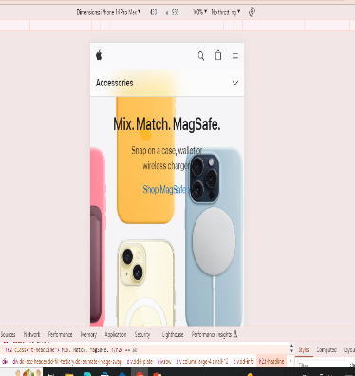
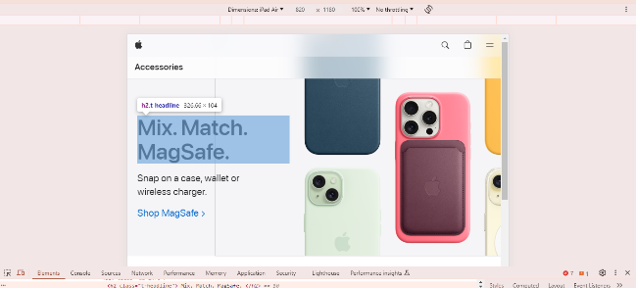
ACCESSORIES PAGE
IPHONE – 430x932 (POTRAIT) RESPONSIVE
IPAD – 820x1180(POTRAIT) RESPONSIVE

Slide 23
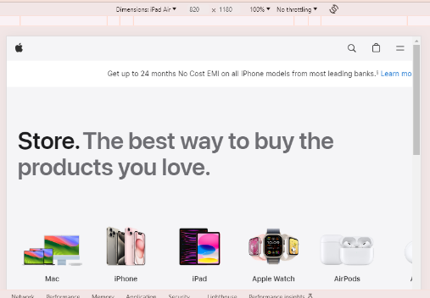
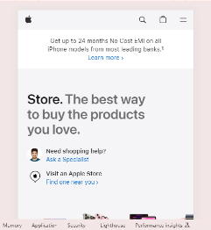
STORE PAGE
IPAD AIR – 820x1180 (POTRAIT) RESPONSIVE
SAMSUNG GALAXY S20 ULTRA 412x915(POTRAIT) RESPONSIVE

Slide 24
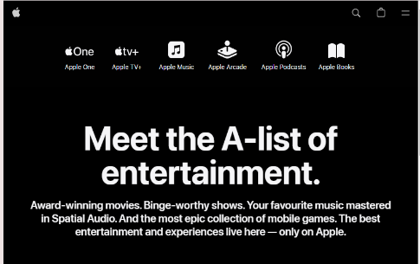
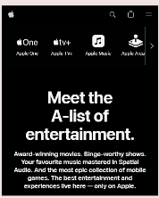
ENTERTAINMENT PAGE
IPAD AIR – 820x1180 (POTRAIT) RESPONSIVE
SAMSUNG GALAXY S20 ULTRA 412x915(POTRAIT) RESPONSIVE

Slide 25
IDENTIFY COMMON WEBSITES DESIGN MISTAKES TO AVOID SUCH AS CLUTTERED LAYOUTS AND SLOW LOADING PAGES

Slide 26

TOOL
GOOGLE PAGESPEED INSIGHTS

Slide 27
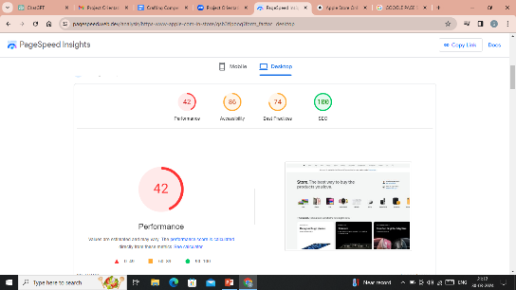
GOOGLE PAGESPEED INSIGHTS
ISSUE – The website is experiencing prolonged loading times, with a notably low performance score indicating suboptimal performance.
SOLUTION – The remedy for mitigating extended loading durations and achieving a higher performance score involves steering clear of oversized layouts to minimize data transfer, trimming unnecessary JavaScript to streamline page rendering, activating text compression to shrink file sizes and bolster loading speeds, and delivering images in next-generation formats such as Web to optimize image loading without sacrificing quality. These optimizations are geared towards improving overall website performance, diminishing page load times, and ultimately enhancing the user experience for visitors. Consistent monitoring and refinement of these solutions are imperative to sustain peak website performance over time.

Slide 28
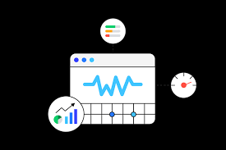
TOOL
WEB VITALS

Slide 29

WEB VITALS
ISSUE – CLS These shifts occur when elements on the page, such as images or ads, load asynchronously or when dynamic content is added after the initial page load without proper dimensions specified. CLS can frustrate users, causing them to click on unintended elements or lose their place on the page.
SOLUTION -To mitigate Cumulative Layout Shift (CLS), developers should prioritize loading critical resources like images and ads with dimensions pre-defined in HTML attributes. Utilizing CSS aspect ratio boxes for images and reserving space for dynamic content can prevent unexpected layout shifts. Minimizing third-party scripts and optimizing web fonts can also reduce CLS.

Slide 30
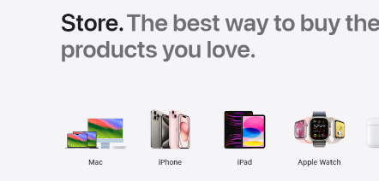
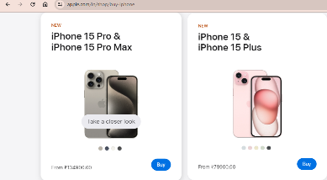
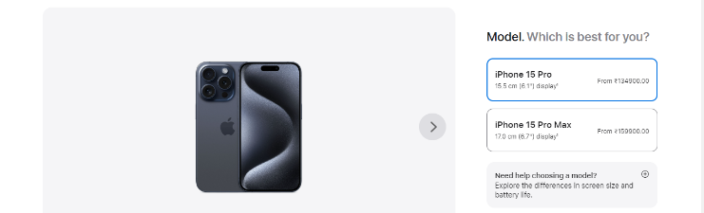
THE PURCHASING PROCESS INVOLVES EXCESSIVE STEPS

Slide 31
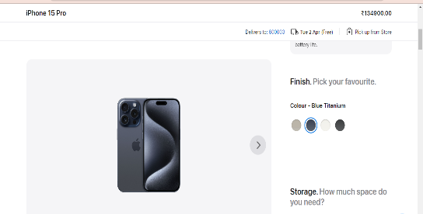
THE PURCHASING PROCESS INVOLVES EXCESSIVE STEPS
ISSUE – complex process in buying a product.
SOLUTION- To address the issue of a cumbersome purchasing process on the Apple website, streamline checkout steps, optimize website performance for faster loading times, implement guest checkout, enable autofill and saved payment information, and ensure clear and concise navigation. Additionally, prioritize mobile optimization and gather user feedback to continually improve the purchasing experience.

Slide 32

TOOL
SITECHECKER

Slide 33
SITECHECKER
ISSUE – When the images are not efficiently encoded.
SOLUTION – Compress images using tools like TinyPNG. Choose appropriate image formats(JPEG for photos,PNG for graphics). Remove unnecessary metadata from images. Utilize responsive images or srcset attributes for varying screen sizes. Optimize image dimension to match display requirements.

Slide 34
TOOL
SITECHECKER

Slide 35
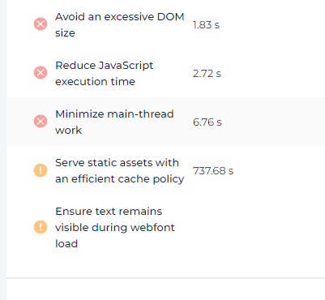
SITECHECKER
ISSUE -The problem includes an excessive Document Object Model (DOM) size, the need to decrease JavaScript execution time, and the requirement to minimize workload on the main thread.
SOLUTION - Implement lazy loading for resources such as images, scripts, and stylesheets to defer their loading until they are needed, reducing initial page load time and improving overall performance. Regularly monitor website performance using tools like Google PageSpeed Insights, Lighthouse, or browser developer tools to identify areas for further optimization and measure the impact of implemented changes.

Slide 36
PROVIDE A LIST OF BEST PRATICES FOR CREATING VISUALLY APPEALING AND USER- FRIENDLY WEBSITE DESIGN

Slide 37

LIST OF BEST PRATICES
Clear Navigation: Intuitive menus and consistent layout for effortless browsing.
Responsive Design: Ensuring seamless functionality across all devices.
Readable Typography: Legible fonts and appropriate sizing for easy reading.
Cohesive Branding: Consistent colours, logos, and styles for brand recognition.
Quality Imagery: High-resolution visuals relevant to content, enhancing engagement.

Slide 38

LIST OF BEST PRATICES
Visual Hierarchy: Prioritizing content through size, color, and placement.
Accessibility: Inclusive design for users of all abilities.
Swift Loading: Optimized performance for quick page loading.
User Feedback: Incorporating insights to refine and improve design continually.
Whitespace: Use whitespace generously to create breathing room between elements and improve visual clarity.

Slide 39
DESIGN A LANDING FOR THEIR PRODUCT OR SERVICE TO GENERATE LEADS

Slide 40

TOOL USED
CANVA

Slide 41
LINK
Hyperlink
Use in full screen(shift + f5) and click the link.
Hyperlink
https://apple-sample-page-project.my.canva.site/by-gandhirajankm
Right click and open hyperlink.

